Slide 1

CSE7101- Capstone Project
Final Review
ANALYTICS AND RECOMMENDATION SYSTEM FOR PGRKAM PLATFORM
Batch Number: CAI - 48
Problem Statement Number: PSCS_16
Roll Number
Student Name
Under the Supervision of,
Dr. Selvaganesh R
Asst. Professor
School of Computer Science and Engineering
Presidency University
20211CAI0150
ROHIT S
20211CAI0182
SYED AZEEM
Name of the Program: CAI
Name of the HoD: Dr. Zafar Ali Khan
Name of the Program Project Coordinator: Dr. Suma NG
Name of the School Project Coordinators: Dr. Sampath A K , Dr. Geetha A

Slide 2
Problem Statement
  While the PGRKAM portal successfully connects a vast network of job seekers and recruiters, it currently operates without integrated analytics or a personalized recommendation system. This gap makes it difficult to track user behavior or understand engagement patterns, resulting in generic job matches and leaving administrators without crucial data-driven insights. As a result, the platform is limited in its ability to offer a seamless user experience, improve employment rates, or provide policymakers with the data needed for strategic workforce planning.
  Goal—to build an integrated platform offering analytics and a job recommender system.

Slide 3
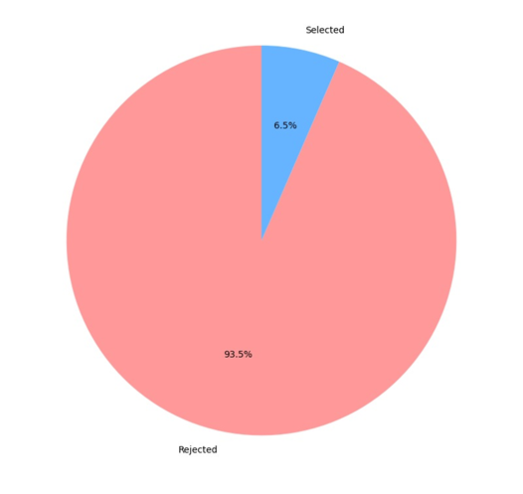
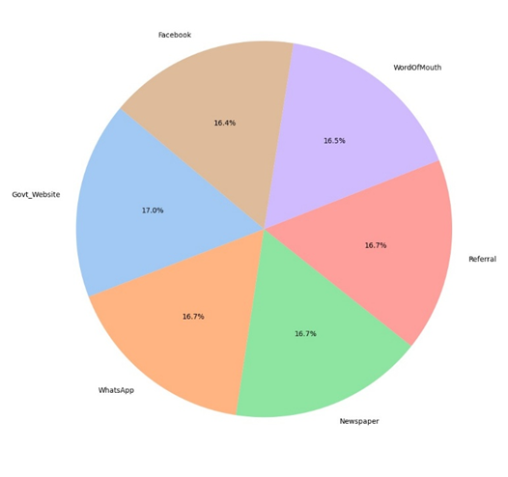
Objectives
• Real-time analytics
• AI-based job recommendations
• Explainable matched skills
Streamlit dashboard
• Synthetic dataset generation
Job Appplication status
User Acquisition Channels

Slide 4

SDG Mapping
Our project aims to:
  SDG 4 – Quality Education
• Skill-aligned job guidance
• Education to job readiness analytics
• Improves youth employability
2.SDG 8 – Decent Work & Economic Growth
•Personalized job recommendations
•Supports government employment services
• Improves labor market participation
  SDG 10 – Reduced Inequalities
• Equal access to job opportunities
• Unbiased recommendations
• Reduces regional & skill-gap inequalities

Slide 5
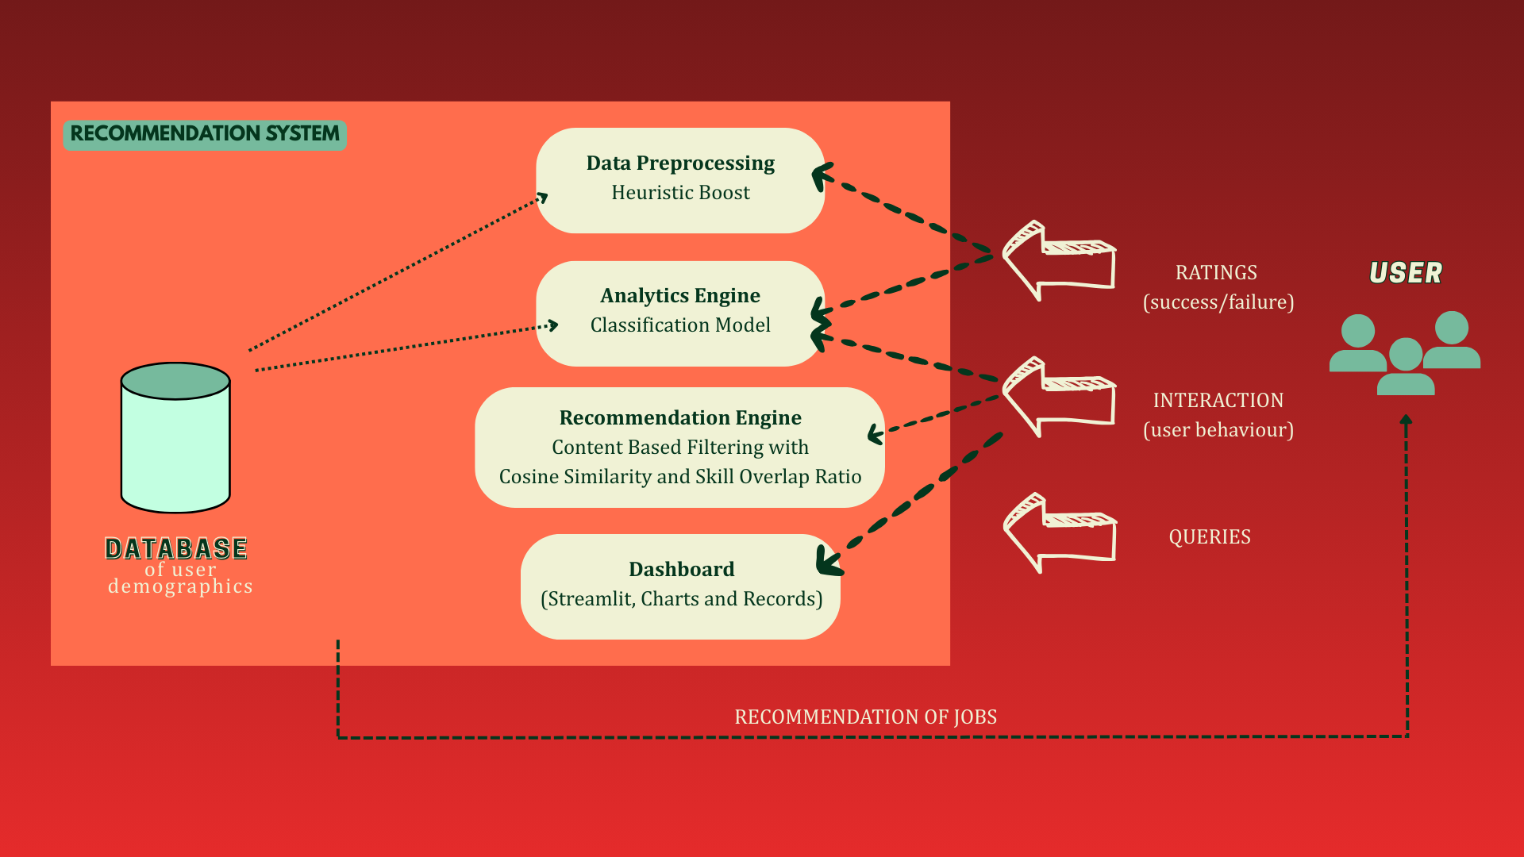
Architecture Diagram

Slide 6
Technologies Used
1. Backend:
  Python.
  Pandas.
  NumPy.
  PostgreSQL.
2. ML (Recommender):
  scikit-learn.
  Cosine similarity.
  Content-based filtering.
3. Frontend:
  Streamlit.
  Plotly.
  Altair.
  Matplotlib.
4. Dev Tools:
  GitHub.
  Faker for synthetic data generation.

Slide 7
Modules
1. Data Collection Module
  Collects user demographics, job postings, applications, and activity logs.
  Input stored as CSVs/databases.
2. Analytics Module.
  Generates descriptive statistics and charts (gender, education, age, location, application success).
  Helps administrators understand user base and trends.
3. Recommender Module.
  Matches skills and job requirements.
  Uses content-based filtering with future scope of collaborative filtering and genetic algorithms.
  Provides explainable recommendations (why the job was suggested).
4. Visualization Module (Dashboard)
  Interactive dashboard for administrators and users.
  Displays analytics, trends, and top job recommendations.

Slide 8
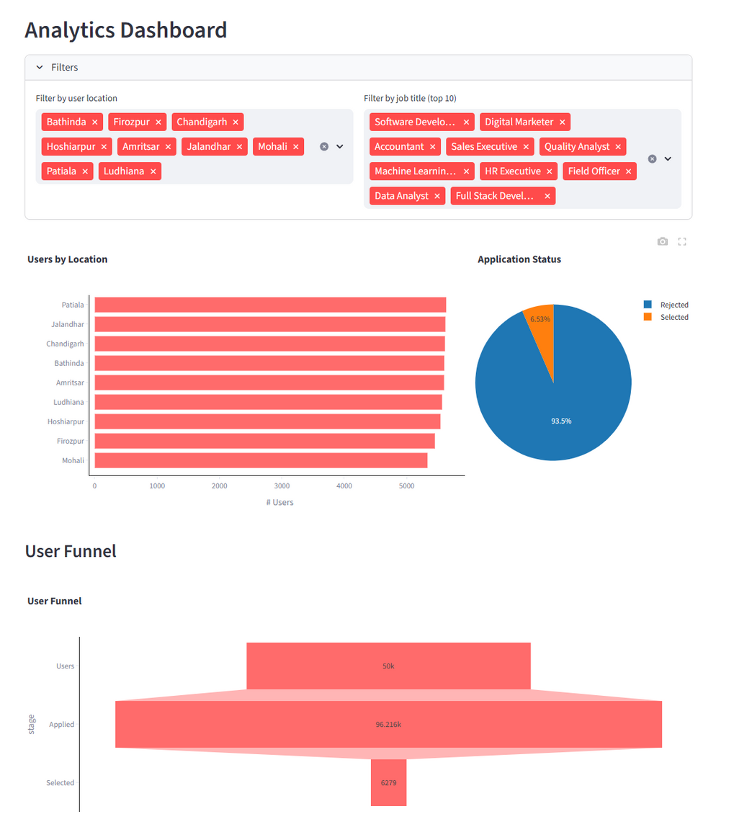
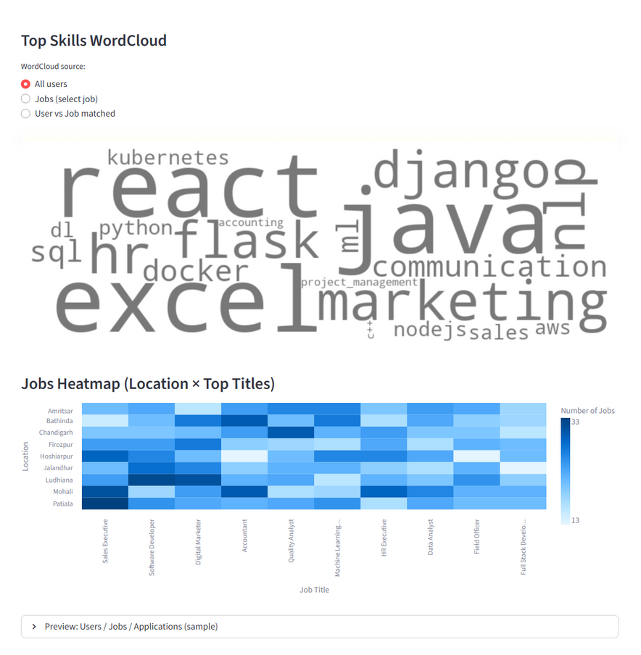
Analytics Module
  Interactive filters for location/job title.
  User Funnel.
  Heatmap of location and job title.
  Pie chart of application success/failure.
  Skills WordCloud.

Slide 9
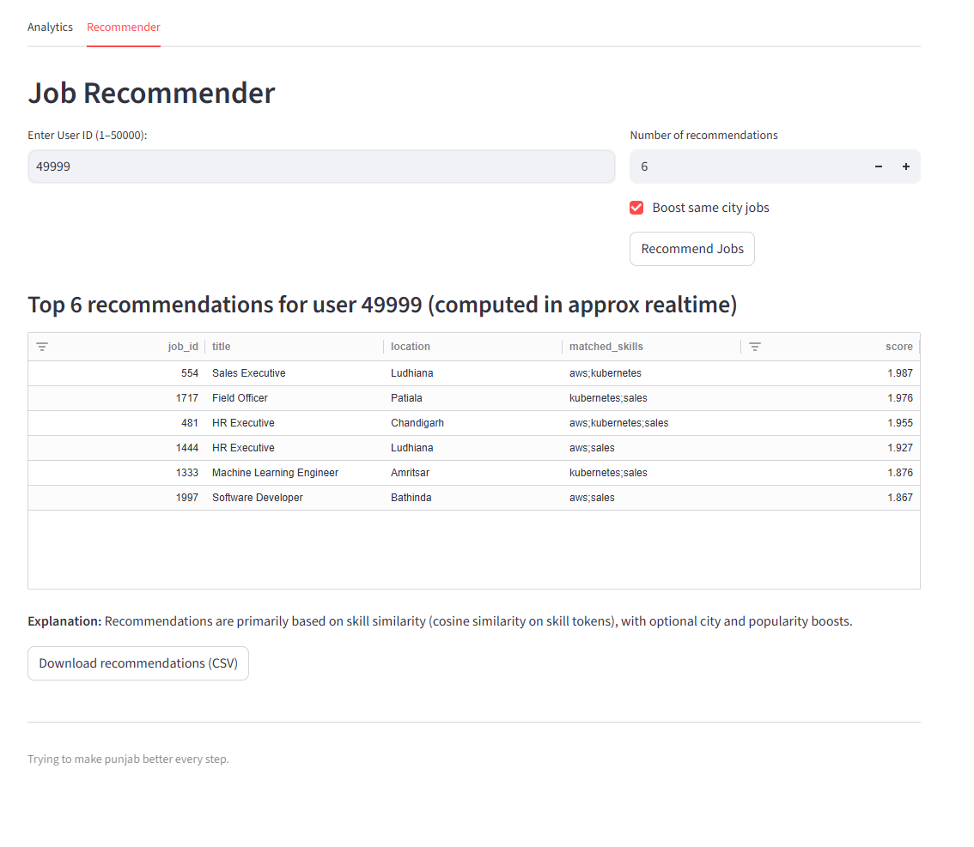
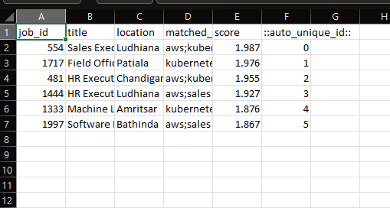
Recommender System
  Content-based filtering.
  Cosine similarity over skill vectors.
  Skill tokenization & overlap scoring.
  Location boosting.
  Popularity boosts.
Downloaded CSV file

Slide 10
Github Link
Github link
-
https://github.com/codebreaker17jpg/PSCS_16.git

Slide 11
Results and evaluation
  The analytics dashboard correctly aggregates users by location and frequency of skills. Recommendations from the system provide substantial improvements in skill overlap when compared to random baselines. In simulated ablation tests, adding a city boost improved apparent precision@5 by several percentage points. Detailed numerical tables are provided as placeholders.
  The testing covered data integrity checks, recommender correctness, UI responsiveness, and load tests for the recommendation endpoint. Test cases validated that the recommended jobs have non-empty matched skills and that city boosts work as expected.

Slide 12
Conclusion & Future Scope
  This project developed and validated a prototype for integrating analytics and a content-based recommender into the PGRKAM employment portal. We demonstrated that, with synthetic data, descriptive analytics and skill-overlap scoring can improve the capabilities in job discovery and provide actionable insights for administrators. Work remains to integrate collaborative filtering for behavioral signals, apply genetic algorithms to perform multiobjective optimization over rank, and leverage semantic matching through LLMs to handle phrasal variation in skill descriptions. A production deployment will also require robust privacy protection, monitoring for fairness, and other forms of outreach to increase rural participation.
  Future work will involve LLM-based semantic parsing of resumes and job descriptions, active learning to collect labeled outcomes, federation of sensitive data for privacy; and a richer admin console for A/B testing and monitoring.

Slide 13


